Slide 1
Choose the Right Cosmos DB API and Consistency Model

Slide 2

Jes Borland Software Engineer @ Microsoft jes.borland@microsoft.com @grrl_geek LessThanDot.com

Slide 3
Abstract
Cosmos DB is Azure's globally distributed, multi-model database service. It offers several APIs, multiple consistency models, automatic indexing, and guaranteed performance. This revolutionary NoSQL database system is changing how developers store and work with their data. But which API and model is right for your application? In this session, you'll learn what types of data each API can store, what benefits each consistency model provides, and use cases for each.

Slide 4

Cosmos DB
Cosmos DB is for NoSQL data
Not relational, not highly structured
This one data store has a common model for multiple types of data structures
Notes:
It’s NOT another SQL Server flavor in Azure!

Slide 5
Benefits of Cosmos DB
Globally distributed
Multiple APIs
Multiple consistency models
Varying levels of throughput
Has performance SLAs
Performs automatic indexing
Fully managed Azure fabric

Slide 6
What kind of data can be stored?
Document
Key/Value
Wide column
Graph

Slide 7
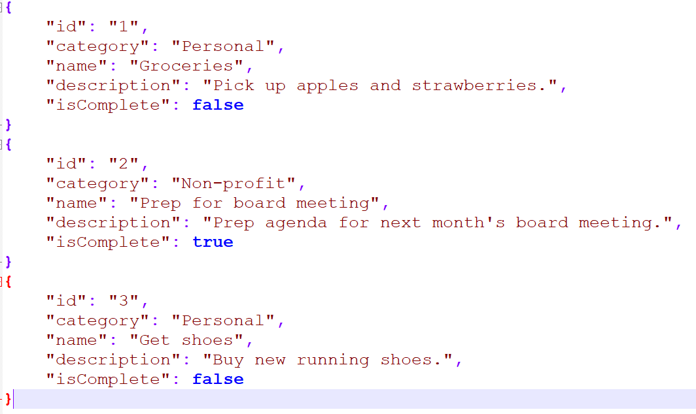
Document
Notes:
JSON files

Slide 8
Key/Value
{1: Washington DC, United States} {2: Ottawa, Canada}
{3: Mexico City, Mexico}
Notes:
A “key” and attributes assigned to that key

Slide 9
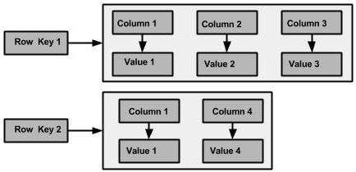
Wide column
Has tables with rows and columns, but names and format of columns vary from row to row in the same table
https://www.tutorialspoint.com/cassandra/cassandra_data_model.htm

Slide 10
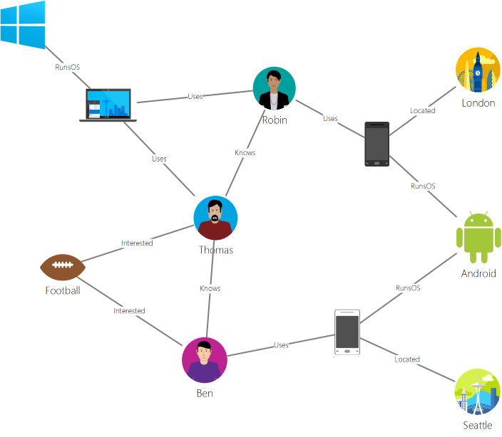
Graph
A non-relational data store that lets you define entities (vertices), and the relationships between them (edges)

Slide 11
APIs

Slide 12
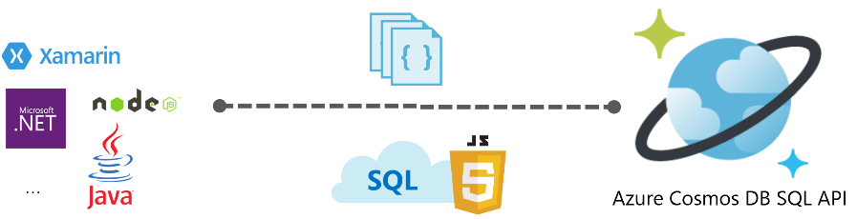
SQL
Document database
The SQL API started life as DocumentDB - a JSON database engine with a query language that will look familiar to those used to T-SQL
Notes:
https://docs.microsoft.com/en-us/azure/cosmos-db/sql-query-getting-started

Slide 13
SQL API Use Cases
Anything that generates JSON data!
IoT
Retail
Gaming

Slide 14
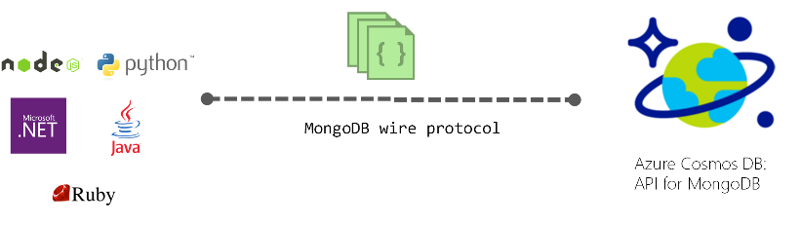
MongoDB
An open-source document database which uses JSON-like documents
Existing Mongo databases can have data imported directly, then the applications that use them can be pointed to Cosmos DB
Existing tools like Mongo Shell can be used with Cosmos DB
Notes:
https://docs.microsoft.com/en-us/azure/cosmos-db/mongodb-introduction

Slide 15
MongoDB API Use Cases
Content Management Systems (CMS)
Timekeeping
IoT

Slide 16

Table
The Table API directly interacts with Azure Table Storage, which is key/value pairs
Gives additional features that Storage alone can't such as global distribution, higher throughput

Slide 17
Table API Use Cases
Replace Redis (an application caching program)
Games and scores per player
Shopping carts
Analytics materialized view for specific dates

Slide 18

Etcd
In Kubernetes, etcd is used to store the state and the configuration of the Kubernetes cluster as key/value pairs
Ensuring availability, reliability, and performance of etcd is crucial to the overall cluster health, scalability, elasticity availability, and performance of a Kubernetes cluster
Notes:
https://docs.microsoft.com/en-us/azure/cosmos-db/etcd-api-introduction

Slide 19
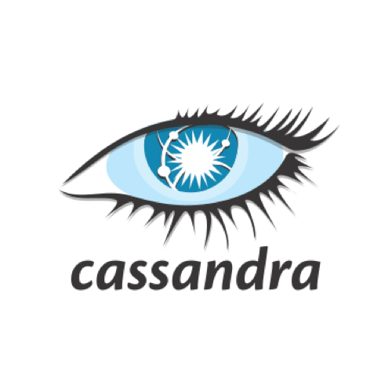
Cassandra
Apache Cassandra is a distributed, wide column store database
Developed at Facebook to power the inbox search feature
Notes:
https://docs.microsoft.com/en-us/azure/cosmos-db/cassandra-introduction

Slide 20
Cassandra API Use Cases
Systems where writes exceed reads
Transaction logging
Package tracking
IoT

Slide 21
Gremlin
Used to store and operate with graph data
Store massive graphs with billions of vertices and edges
Uses the Apache TinkerPop language "Gremlin"
It's very different from SQL!
Notes:
https://docs.microsoft.com/en-us/azure/cosmos-db/graph-introduction

Slide 22
Gremlin API Use Cases
Social networks
Vertices - people
Edges - relationships
Recommendations
Vertices - restaurant, location, cuisine type
Edges - cuisine type, distance to specific location
Logistics
Vertices - airports
Edges - flights

Slide 23
Partition key

Slide 24
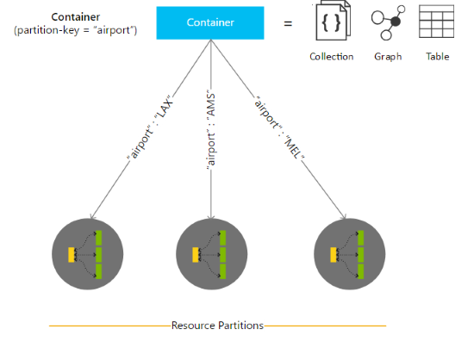
Horizontal Partitioning
Partitioning maps data to physical storage
You choose a logical partitioning key
Choose wisely
The partition key will determine how data is returned when you query it later
Notes:
Partitions & partition key. Partition is per container.
Cosmos picks the # of partitions
IOT example: partition key is device id because in the end, will want to query by device, so you want everything to be together
RUs are greatly affected by partitions
RUs are evenly split per partition
Partitioning in Azure Cosmos DB - https://docs.microsoft.com/en-us/azure/cosmos-db/partitioning-overview#choose-partitionkey

Slide 25
Partition guidance and performance
Queries that access data in a single logical partition are more cost-effective than queries that access multiple.
Transactions are allowed only against a single logical partition.
The best choice is something with high cardinality
What is high cardinality? More uniqueness.
Binary is low cardinality - true/false
Unique ID is high cardinality
First name may be somewhere between

Slide 26
FAQ
Can I change the partitioning key?
No. You would have to create a new collection with the new partition key and move the data.
Is there a tool to help?
Partition Key Advisor: http://partitionkeyadvisor.azurewebsites.net/ or https://github.com/Azure-Samples/azure-cosmos-db-partition-key-advisor
Video: https://www.youtube.com/watch?time_continue=466&v=9v6WbCOzPiM

Slide 27
Consistency Levels

Slide 28
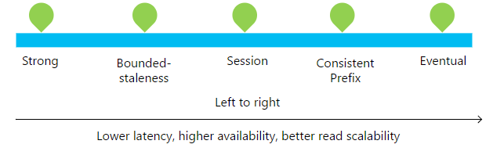
Consistency Levels
SQL Server has isolation levels
Read Uncommitted
Read Committed
Repeatable Read
Snapshot
Serializable
Cosmos DB has consistency levels
Eventual
Consistent prefix
Session
Bounded stateless
Strong
Notes:
Set with CLI, PowerShell, Portal
Consistency can be changed per request in app code.
https://docs.microsoft.com/en-us/azure/cosmos-db/how-to-manage-consistency#configure-the-default-consistency-level

Slide 29
Notes from Carl
Eventual – writes de-prioritized; reads are cheap.
Strong – write-optimized.
Most lift and shift will start with Strong then shift. Don’t just Lift, otherwise can be very expensive.
Are all consistency levels available with all APIs? Yes. Set default consistency level at Account level.
Not sure what to do? Use Graph.

Slide 30
Open Portal

Slide 31
Strong
A write is only visible after it's committed to a majority quorum of replicas
Reads are guaranteed to return the most recent version
Best if used in only one region
Examples
Banking accounts
Payment processing
Reservation systems
“Absolute truth every time”

Slide 32
Bounded stateless
Reads can lag behind writes in a "staleness windows"
K versions
t time interval
Global total order outside of that window
Recommended for globally-distributed applications
Examples
Flight status app
Package tracking app
“Not too old”

Slide 33
Session
Cosmos DB default
Consistency is scoped to a single session
Guarantees RYW - read your own writes
Examples
Social profile updates
Retail shopping cart
Social music app preferences
“Logical, real-time experiences for a user”

Slide 34
Constant Prefix
If there are no more writes, all replicas will have the same data
….and in the correct order
Examples
Baseball score updates
Social media comments
“The order of the data tells as much of a story as the end result”

Slide 35
App writes:
Jes
Erin
Sarah
Client 1 sees:
Jes
Erin
Client 2 sees:
Jes
Client 3 sees:
Jes
Erin
Sarah

Slide 36
Eventual
Eventually, with no further writes, all replicas in a group eventually converge
A session may get values older than what it saw on a previous read
Examples
Product reviews
Social media following posts
Receipts
“Apps that live and die according to their availability”

Slide 37
Summary

Slide 38
Why Cosmos DB?
Distributed worldwide
Scalable up/down
Flexible consistency models
Meets or exceeds performance SLAs
Notes:
What problems does it solve?
Applications need a back end data store that is:
Distributed worldwide
Scalable up/down for surges and dips in usage
Flexible with consistency models
Meets or exceeds performance SLAs

Slide 39
What kind of data can be stored?
Document
Key/Value
Wide column
Graph

Slide 40
APIs
SQL
Mongo DB
Table
Etcd
Gremlin
Cassandra

Slide 41
Consistency Levels
Eventual
Consistent prefix
Session
Bounded stateless
Strong

Slide 42
Resources
Azure Cosmos DB product page - https://azure.microsoft.com/en-us/services/cosmos-db/
Documentation - https://docs.microsoft.com/en-us/azure/cosmos-db/
eBook - https://discover.microsoft.com/apps-for-cats/ (Highly recommended, less than half an hour to go through.)

Slide 43
Questions?

Slide 44
Jes Borland Software Engineer @ Microsoft jes.borland@microsoft.com @grrl_geek LessThanDot.com

